Slide 1
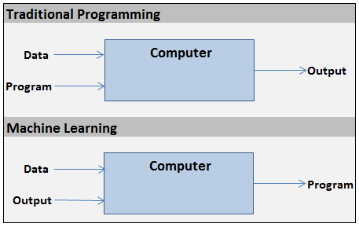

Slide 2


x₁
Summation/
Hypothesis
w₁
Activation (i.e. step)
x₂
w₂
x₃
w₃
output
x₄
w₄
Σ
y
inputs
w₅
x₅
.
.
.
w_{n}
h(X) = x₁w₁ + x₂w₂ + … + x_{n}w_{n}
x_{n}
1, if h(X) >= 0
y =
weights
0, if h(X) < 0

Slide 3
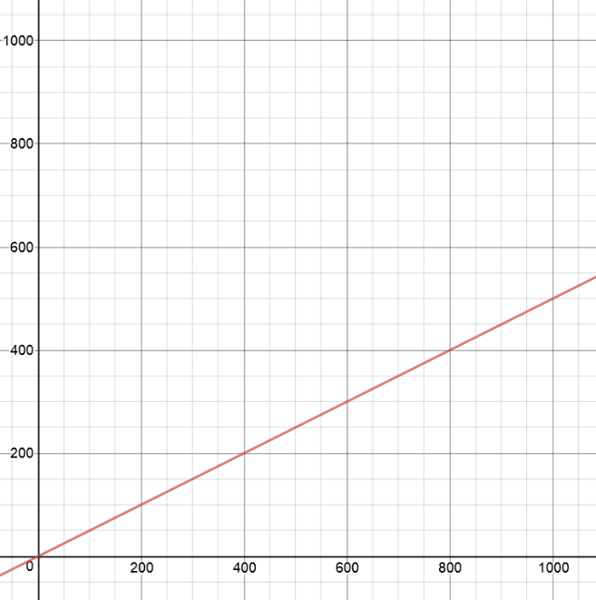
point to test
2nd input –
y-coordinate
y = 0.5 * x
1st input –
x-coordinate

Slide 4
x-coordinate
x₁
w₁
output
Σ
y
inputs
w₂
x₂
weights
y-coordinate

Slide 5
learning rate – small number
(i.e. 0.01)
x-coordinate
w₁ = w₁ – error * x₁ * α
x₁
w₁
error =
Σ
y - ŷ
Inputs
w₂
actual
value
guess
x₂
w₂ = w₂ – error * x₂ * α
y-coordinate

Slide 6
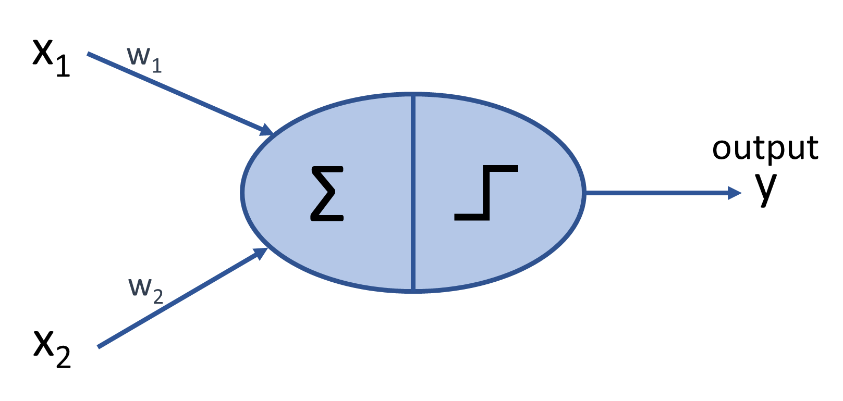
After 1000 training points:
w1 = -18.29
w2 = +36.82
-18.29x + 36.82y = 0
y = (18.29/36.82)x
y = 0.4969x
accuracy 99.9%
y = 0.5x
Notes:
Bonus task: try to see how the learning rate affects the ‘speed’ with which the model converges. What’s the largest learning rate that can be used while still enabling the model to converge. How does this affect the minimum number of training points required?

Slide 7
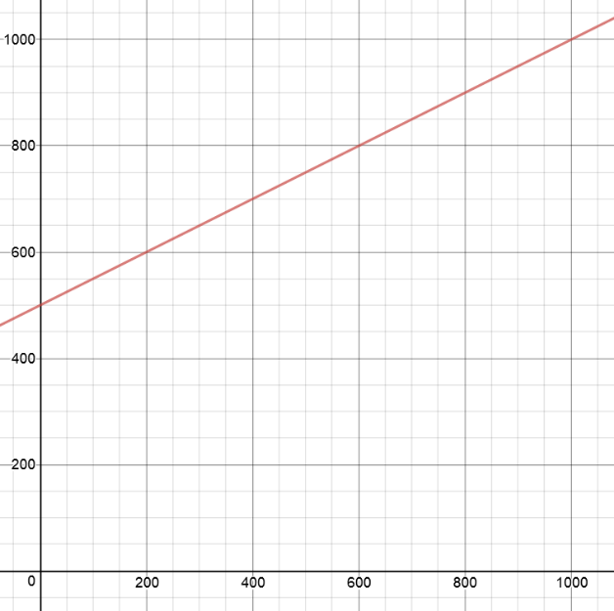
2nd input –
y-coordinate
y = 0.5x + 500
point to test
1st input –
x-coordinate

Slide 8
x-coordinate
x₁
w₁
y-coordinate
output
w₂
Σ
y
x₂
inputs
w₃
x₃
h(X) = x₁w₁ + x₂w₂ + w₃
= xw₁ + yw₂ + w₃ = 0
bias (always = 1)
y = x (-w₁/w₂) – (w₃/w₂)

Slide 9
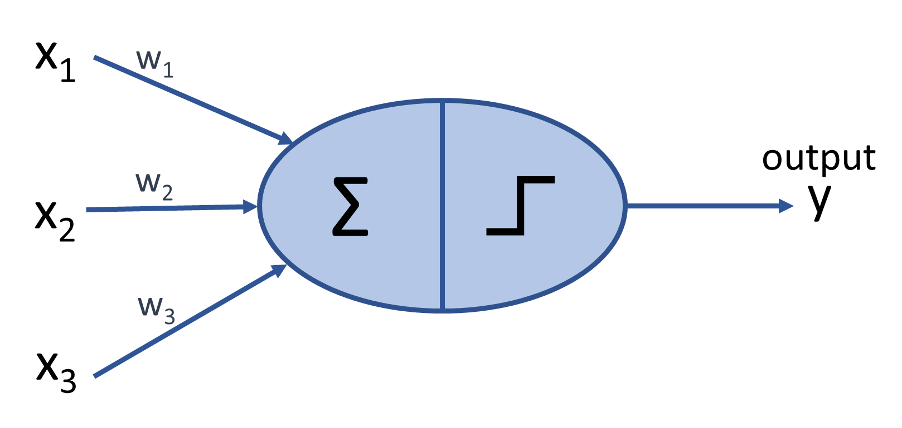
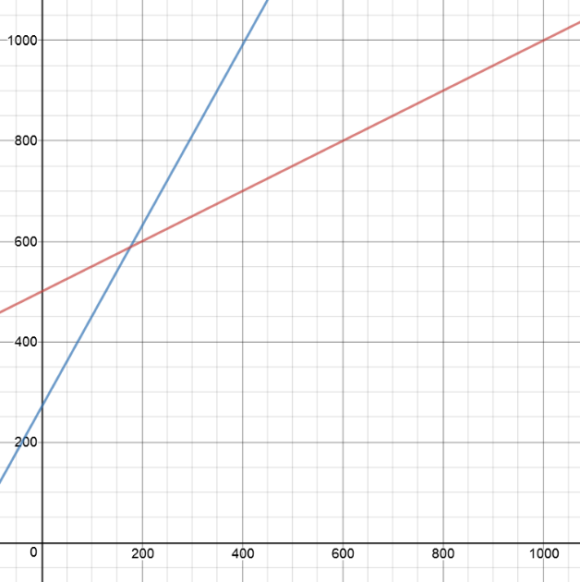
y = 0.5x + 500
After 10 million training points:
w1 = -28.5
w2 = +16.0
w3 = -4329.5
-28.5x + 16.0y -4329.5 = 0
y = (28.5/16.0)x + (4329.5/16.0)
y = 1.8x + 270.6
accuracy 85.7%

Slide 10
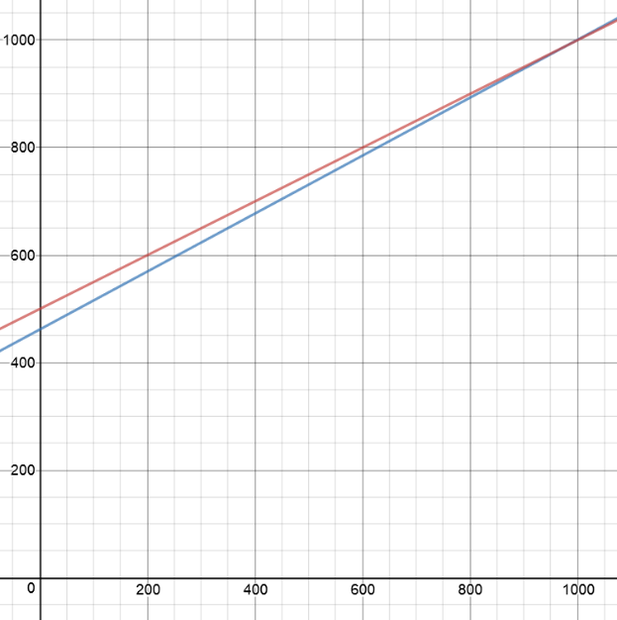
y = 0.5x + 500
After 100 million training points:
w1 = -19.20
w2 = +35.63
w3 = -16457.09
-19.20x + 35.63y -16457.09 = 0
y = (19.20/35.63)x + (16457.09/35.63)
y = 0.5389x + 461.889
accuracy 97.7%
Notes:
Bonus question: why does this model take so long to converge? How can this be fixed? (Answers: normalize inputs or increase ‘default’ bias to 1000)

Slide 11
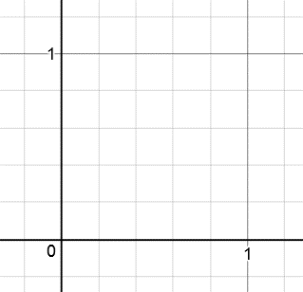
2nd input –
y-coordinate
TRUE when 1st AND
2nd inputs are
both = 1
FALSE when 1st AND
2nd inputs are not
both = 1
1st input –
x-coordinate
Notes:
Question: are we going to need bias? (Answer: yes)

Slide 12
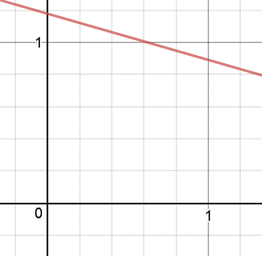
y = -.28769x + 1.1785
accuracy 100%
After 1000 training points:
w1 = +0.01183
w2 = +0.04112
w3 = -0.04846
.01183x + .04112y -.04846 = 0

Slide 13
2nd input –
y-coordinate
TRUE when 1st OR
2nd inputs are = 1
FALSE when neither
1st OR 2nd inputs
are = 1
1st input –
x-coordinate
Notes:
Question: are we going to need bias? (Answer: yes)

Slide 14
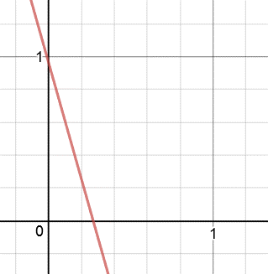
y = -3.5557x + .9651
accuracy 100%
After 1000 training points:
w1 = +0.72241
w2 = +0.20317
w3 = -0.19608
.72241x + .20317y -.19608 = 0
Notes:
Note: that line is cutting it really, really close to (0,1). Neural networks, unlike SVMs, will not maximize the margins between the classes.

Slide 15
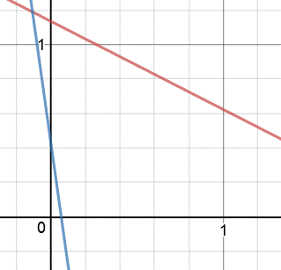
OR classification line:
y = -7.13775x + .42821
accuracy 100%
After 1,000,000 training points
AND classification line:
y = -.51216x + 1.13462
accuracy 100%
Notes:
Question: what is the smallest number of training points needed to achieve 100%? How can the learning rate affect this?

Slide 16
XOR is TRUE when
1st input ≠ 2nd input
XOR is FALSE when
1st input = 2nd input
2nd input –
y-coordinate
1st input –
x-coordinate
Notes:
Question: where are we going to draw the line? (Answer: this graph is “linearly inseparable.”)

Slide 17
hidden layer
output layer
input layer
x₁
w₂₁
x-coordinate
Or 1st operand
w₁₁
a₁
Σ
output
Σ
w₂₂
y
w₂₃
w₁₂
w₁₃
w₂₄
x₂
1
1
y-coordinate or
2nd operand
bias
bias

Slide 18
x-coordinate/
1st operand
hidden layer
1
bias
x₁
w₁₃
w₁₁
a₁
Σ
w₂₁
w₃₁
Σ
output
y
w₃₂
Σ
w₁₂
w₁₃
a₂
w₃₃
x₂
w₂₂
1
w₂₃
y-coordinate/
2nd operand
1
bias
bias

Slide 19
x₁∩x̄₂
x₁\x₂ | 1 | 0
1 | 0 | 1
0 | 0 | 0
a₁∪a₂
a₁\a₂ | 1 | 0
1 | 1 | 1
0 | 1 | 0
x₁
Σ
a₁
Σ
output
y
Σ
w₁₃
a₂
x₁\x₂ | 1 | 0
1 | 0 | 1
0 | 1 | 0
x₂
x₁\x₂ | 1 | 0
1 | 0 | 0
0 | 1 | 0
x₁⨁x₂
x̄₁∩x₂

Slide 20
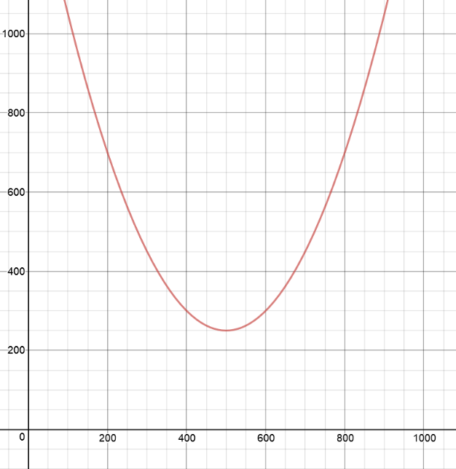
y = 0.005(x – 500)² + 250
2nd input –
y-coordinate
point to test
1st input –
x-coordinate

Slide 21
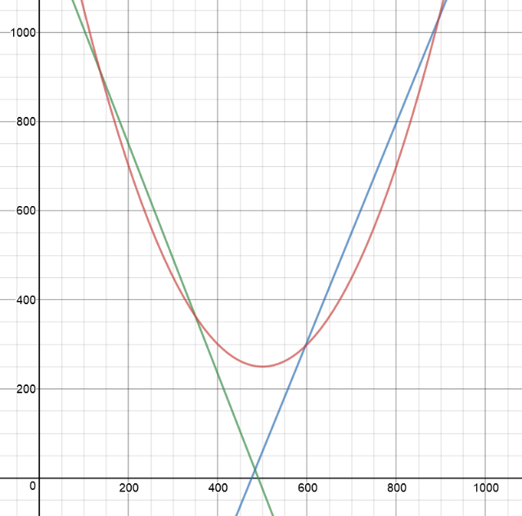
y = 0.005(x – 500)² + 250
y= -2.58x + 1264
y= 2.46x - 1170

